Slide 1
Remote Procedure Call
Notes:
Explain The concept of the RPC.

Slide 2
Remote Procedure Call
Call
_____________
the function/method/___________
resides in
_______________________
located computer for execution.
Procedure
Remote
Notes:
Explain The concept of the RPC.

Slide 3
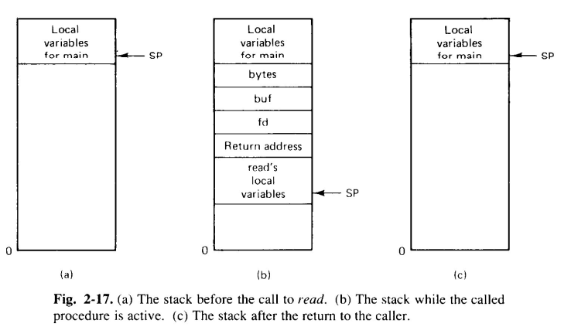
Conventional Procedure Call

Slide 4
Conventional Procedure Call
Caller process executes the call and is suspended until called function completes and results are returned.
Parameters are stored to the stack

Slide 5
Conventional Procedure Call
Remote Procedure
Caller process executes the call and is suspended until called function completes and results are returned.
Parameters are stored to the stack
Passed
Machine where procedure will be executed

Slide 6
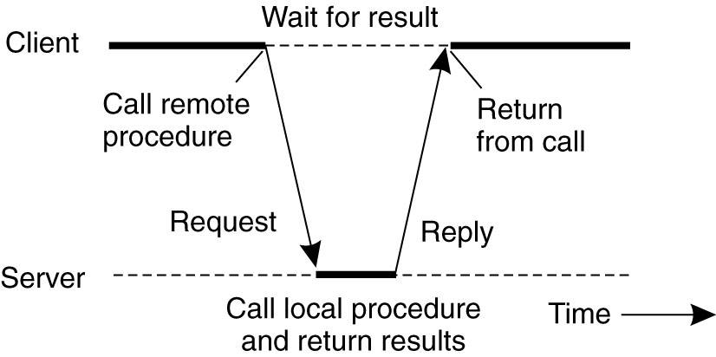
RPC
Caller process executes the remote call and is suspended until called function completes and results are returned.
Parameters are passed to the machine where the procedure will execute.
When procedure completes, results are passed back to the caller and the client process resumes execution at that time

Slide 7
Stubs
The methods that will take of care of :-
Packing and unpacking of parameter
Message passing
Client Stubs
Server Stubs

Slide 8
Client Stub
Builds a message containing parameters and calls local OS to send the message
Packing parameters into a message is called parameter marshalling.
Stub procedure calls receive( ) to wait for a reply (blocking receive primitive)

Slide 9
Server Stub
Unpack parameters, make a call to the server
When server function completes execution and returns answers to the stub, the stub packs results into a message
Call OS to send message to client machine

Slide 10
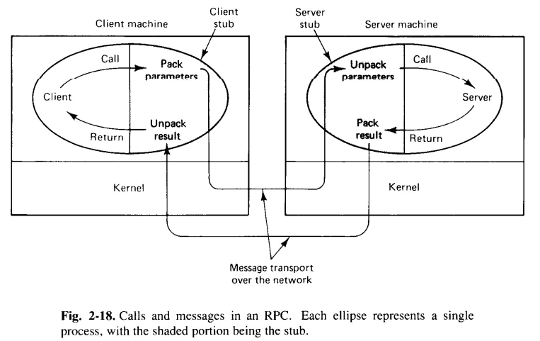
RPC

Slide 11
RPC Steps
1. The client procedure calls the client stub in the normal way.
2. The client stub builds a message and calls the local operating system.
3. The client’s OS sends the message to the remote OS
4. The remote OS gives the message to the server stub
5. The server stub unpacks the parameters and calls the server.
6. The server does the work and returns the result to the stub.
7. The server stub packs it in a message and calls its local OS.
8. The server’s OS sends the message to the client’s OS.
9. The client’s OS gives the message to the client stub.
10. The stub unpacks the result and returns to the client.
Transparency issue

Slide 12
RPC: Issues
Data Representation
RPC call fail or duplication
Binding

Slide 13
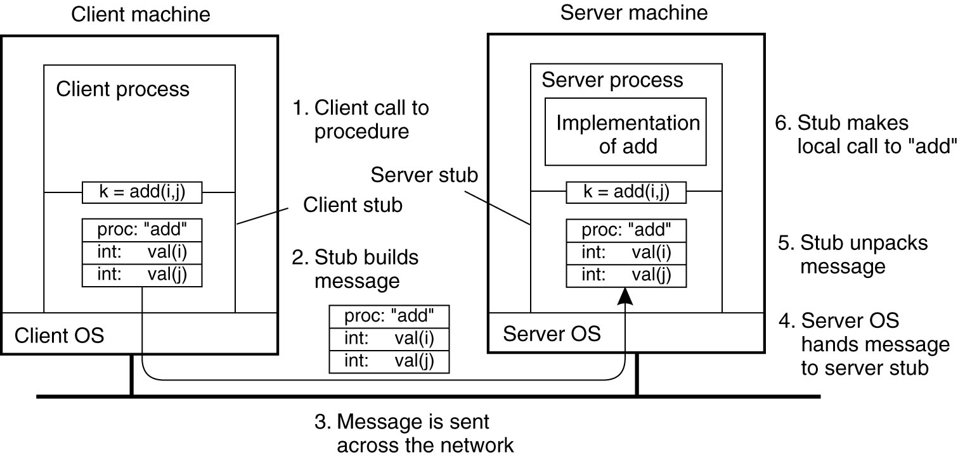
RPC: Parameter Passing

Slide 14
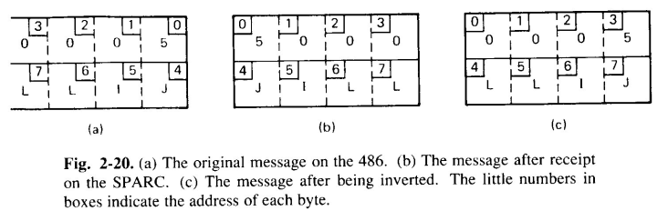
RPC: Parameter Passing
For value parameters, value can be placed in the message and delivered directly, except …
Are the same internal representations used on both machines? (char. code, numeric rep.)
Is the representation big endian (like Sun SPARC), or little endian (Intel format)?

Slide 15
RPC: Parameter Passing
Consider passing an array in the normal way:
The array is passed as a pointer
The function uses the pointer to directly modify the array values in the caller’s space
Pointers = machine addresses; not relevant on a remote machine
Solution: copy array values into the message; store values in the server stub, server processes as a normal reference parameter.

Slide 16
RPC: issues (contd…)
Client and server must also agree on other issues
Message format
Format of complex data structures
Transport protocol (TCP/IP or UDP?)
External Data Representation
Parameters Marshalling

Slide 17
RPC: issues (contd…)
Call Failure, or duplication of call
Message should acted once rather than at-most once
Once: ACK

Slide 18
RPC: issues (contd…)
Binding of client and server through port number
Fixed port addresses
Match maker

Slide 19
Reliable versus Unreliable RPC
If RPC is built on a reliable transport protocol (e.g., TCP) it will behave more like a true procedure call.
On the other hand, programmers may want a faster, connectionless protocol (e.g., UDP) or the client/server system may be on a LAN.
How does this affect returned results?

Slide 20
Asynchronous RPC
Allow client to continue execution as soon as the RPC is issued and acknowledged, but before work is completed
Appropriate for requests that don’t need replies, such as a print request, file delete, etc.
Also may be used if client simply wants to continue doing something else until a reply is received (improves performance)
What are the problems with unreliable, asynchronous RPC?

Slide 21
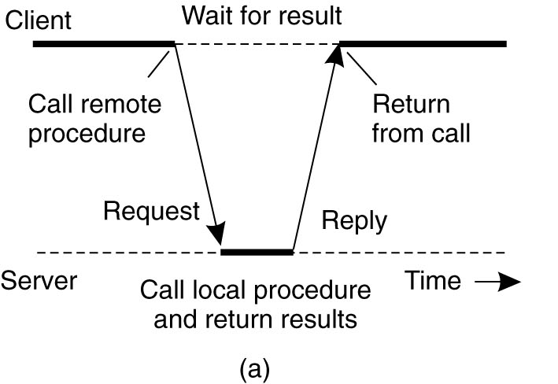

Slide 22
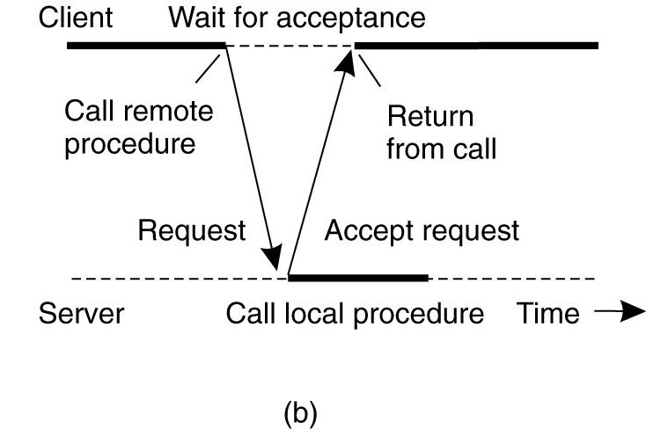

Slide 23
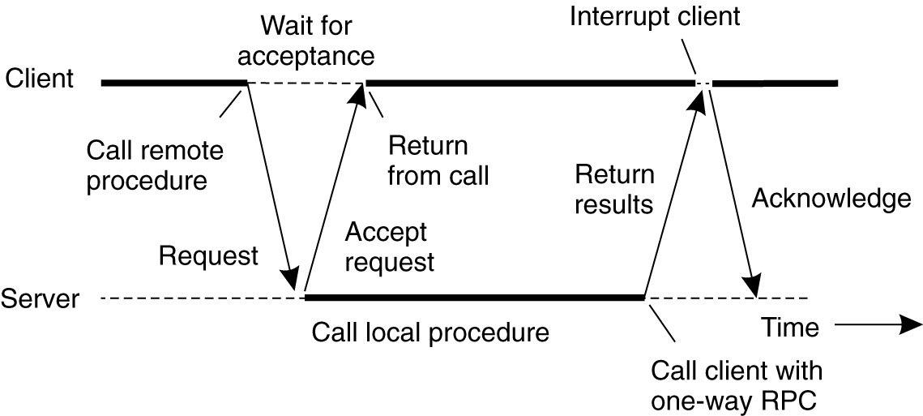

Slide 24
Reference
A S Tanenbaum, Maarten Van Steen, Distributed Operating systems, Pearson, 2014

